Slide 1
Micro Perspective on Urban Pathways Implementation
Projects

Slide 2
Starting with:
Thursay
Pilot Projects
> 50.000 Euro
Starting with
Proof of concept
projects
> 5.000 Euro
Large Scale
Bankable Projects
> 5.000.000 Euro

Slide 3
Your CITY
Your SOLUTIONS
Your IDEAS
What & How we can start implementing
Proof of concept projects

Slide 4
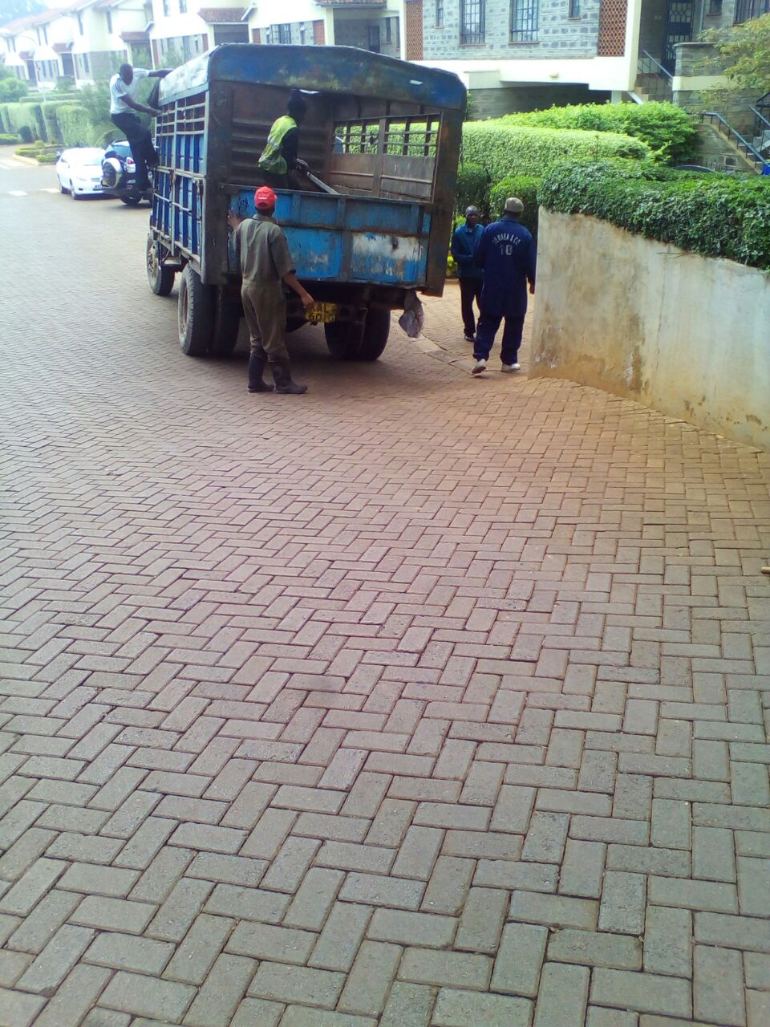
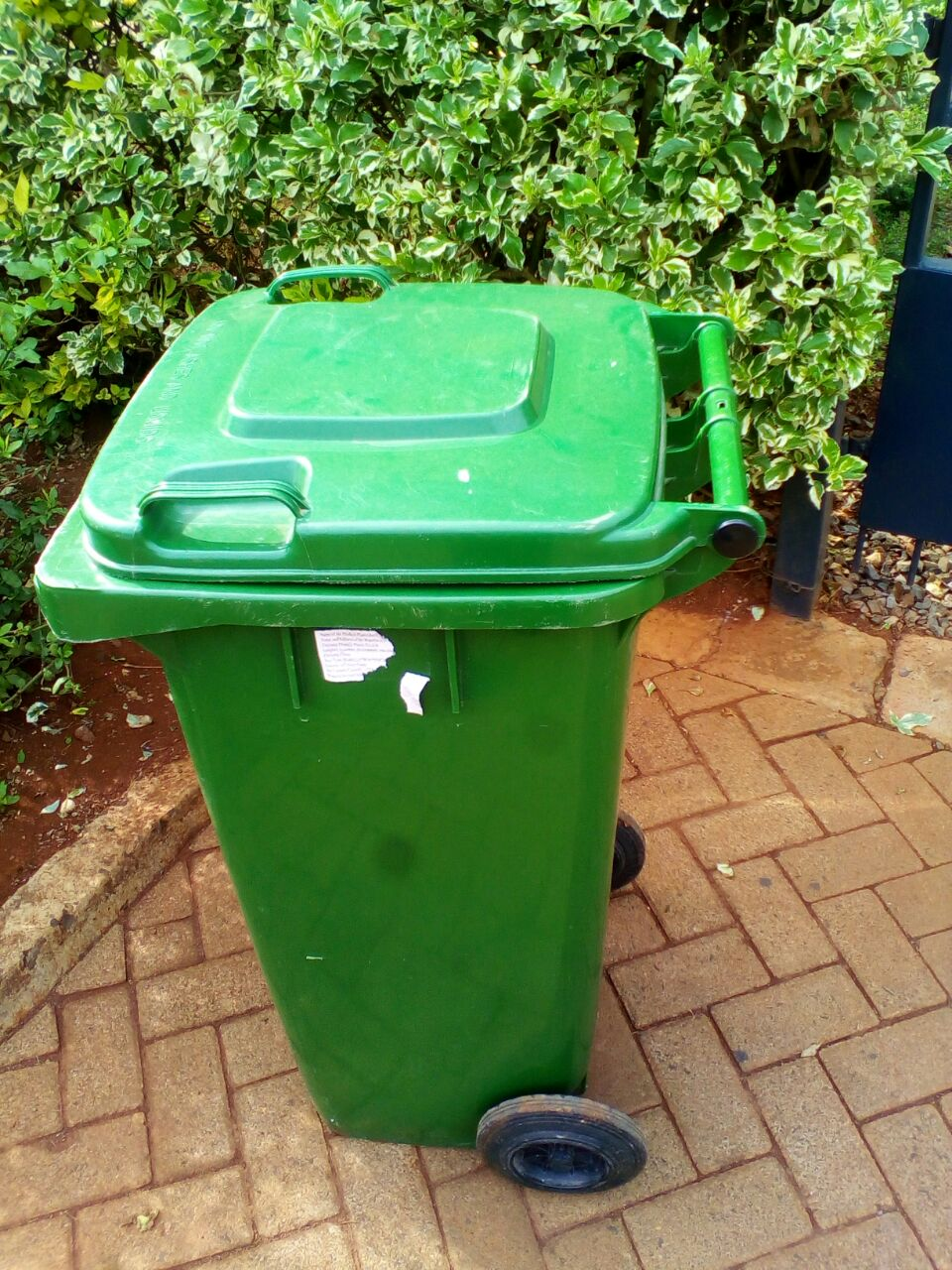
What ? I Where? I Who? I How can we help?

Slide 5
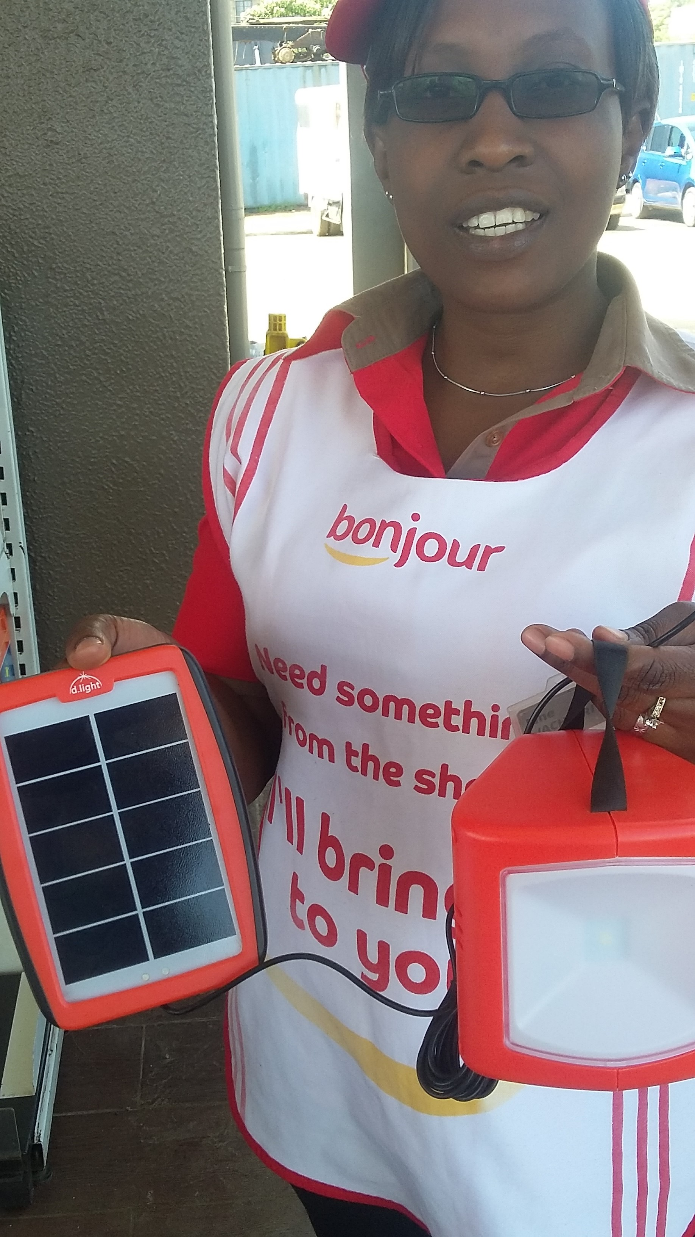
What ? I Where? I Who? I How can we help?

Slide 6
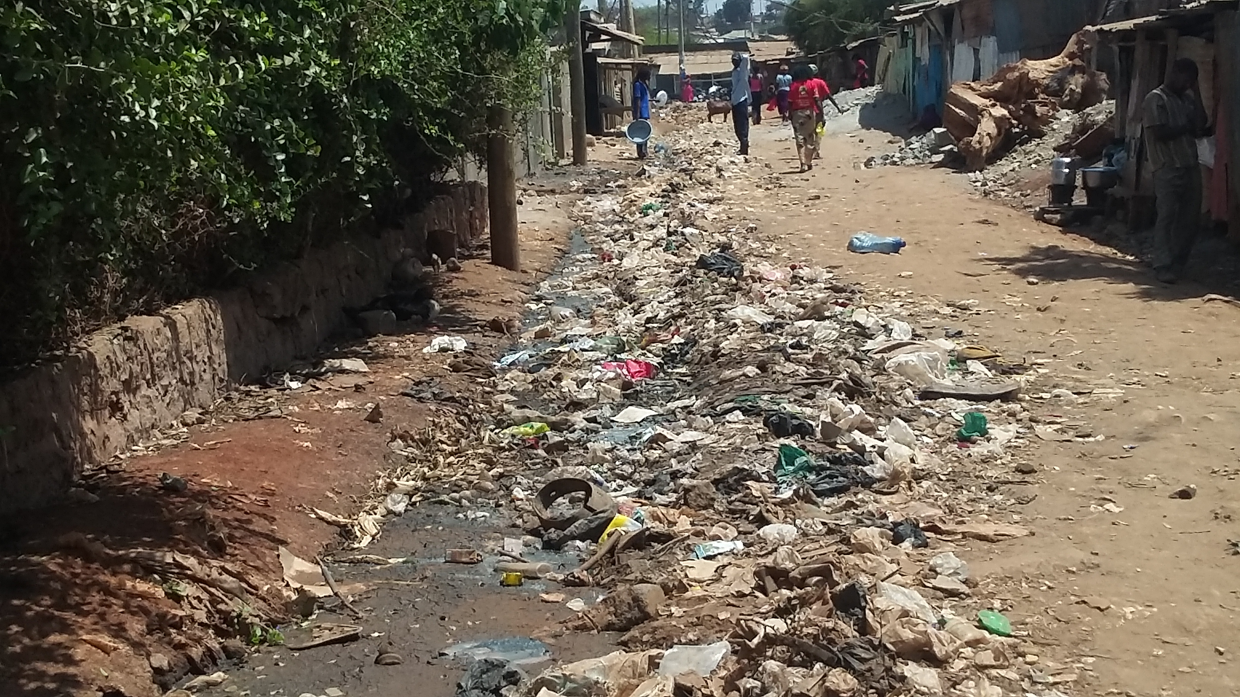
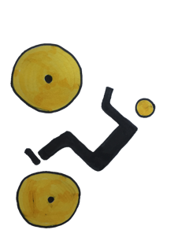
What ? I Where? I Who? I How can we help?

Slide 7
Urban Pathways provides:
Capacity building
Concept Development
Stakeholder partnerships
Advice on finance options
Support in the implementation process

Slide 8
Thursday
Pilot Projects
> 50.000 Euro
Today we start with:
Proof of concept
Projects
> 5.000 Euro
Large Scale
Bankable Projects
> 5.000.000 Euro
Lets discuss:
What solutions could be suitable for your city?
Where specifically in your city could this be applied?
Who would we need to work with?
How can we help you?

Slide 9
Now let´s talk about your city!

