Slide 1
The International Climate Initiative (IKI)
Hermann Amecke, SW I 3
BMUB

Slide 2
Germany’s Climate and Biodiversity Financing

Slide 3
Germany’s International Climate Finance 2005-2015 (in EUR millions)*
Source: BMZ
Notes:
Source: BMZ website: http://www.bmz.de/en/issues/klimaschutz/climate-finance/index.html, layout adjusted
Germany has a solid track record of adhering to the pledges it has made during international negotiations to provide financing and has rapidly increased the funds provided over the past decade (> sixfold within ten years)!
Industrialised countries honoured their pledge made in Copenhagen at COP 15 to provide additional public funding (or 'fast-start financing') of USD 30 billion for 2010 to 2012. The German Government has pledged EUR 1.26 billion. Germany’s fast-start financing for the period 2010–2012 amounted to a total of EUR 1.29 billion (exceeding its pledge by EUR 30 million).
During COP 18 in Doha in 2012, Germany announced that it would increase its budget for international climate finance to EUR 1.8 billion. In 2013, Germany stepped up its work and exceeded the planned EUR 1.8 billion budgetary pledge for climate finance by approximately EUR 0.2 billion. In 2014 Germany became the biggest bilateral donor for climate financing projects (pledging public funding of EUR 2.3 billion) for the first time.
Bilateral German climate finance (BMUB+BMZ) in 2013 according to sector: 38.9% mitigation, 38.3% adaptation, 22.8% REDD+/biodiversity
Bilateral German climate finance (BMUB+BMZ) in 2013 according to region: 18% Latin America/Caribbean; 31% Africa; 30.5% Asia/Middle East/South-East Europe; 20.5% global
German bilateral climate financing 2014 according to sector: 46.6% mitigation, 53.4% adaptation (combined share of 21% REDD+/biodiversity, with equal parts given to both areas)
Bilateral German climate financing 2014 according to sector: 15.7% Latin America/Caribbean; 34.9% Africa; 30.7% Asia/Middle East/South-East Europe; 18.8% global

Slide 4
The International Climate Initiative (IKI)

Slide 5
From its Establishment… Until Today…
Support INDC Development
2014/2015
Creation of the NAMA Facility
2012
2013
GCF-Readiness Programme
Global Climate Partnership Fund (GCPF) and MRV Partnership
2010
2011
Additional Support Area for Biological Diversity
2008
First IKI-Projects start
2017
2016
Globale NDC Partnership / IKI NDC Support Cluster
Notes:
Information: The timeline can also adapted to special thematic priority areas.
Since 2008 IKI has accepted over 500 projects with a total funding volume of EUR 2,3 billion (as at 6 February 2017). 870 Mio between 2015 and 2016 alone
2008 – IKI is established
Revenues generated by the sale of emissions certificates mobilise additional funds that can be directly used for climate change mitigation.
2010 – Climate partnership
Germany, South Africa and South Korea establish the “International Partnership on Mitigation and MRV”, now called: „International Partnership on Transparency (IPT)”. IKI has supported the partnership’s secretariat since the beginning, which is promoting transnational transfer of knowledge related to greenhouse gas reduction through exchange of practical experiences. The partnership also supports capacity building related to MRV.
2011 – Additional support area for biological diversity
‘Conserving biological diversity’ is integrated into IKI’s portfolio as an independent fourth area of support. The biodiversity finance provided by IKI is focused on the medium and long-term goals (Aichi Targets) and priorities described in the Strategic Plan of the CBD.
2012 – Creation of the NAMA Facility
On the sidelines of the climate negotiations in Doha 2012, BMUB and the UK Department of Energy and Climate Change (DECC) established the Facility. Around EUR 70 million was made available for the first selection period in 2013. By the end of 2014, the funding had increased to EUR 120 million, and nine projects from nine countries were selected by the NAMA Facility for support.
2013 – Preparations for the Green Climate Fund (GCF)
IKI is providing EUR 15 million for the GCF Readiness Programme, which prepares recipient countries with concrete individual measures for the Green Climate Fund’s financial and project standards and puts them in a position to receive money from the GCF.
2015 – Paris Agreement: from (I)NDCs to NDCs
IKI supported over 30 partner countries in the development of their INDCs as well as with technical expertise, and closely supported the INDC development process.
2016 – Initiatives for implementing NDCs
In 2016 Germany launched the global NDC Partnership. There are currently 42 countries in the NDC Partnership (developing countries and industrialised countries) as well as eight international/regional organisations. The aim of this political initiative is to promote mutual exchange and learning and support the partner countries in the coordination of NDC implementation in order to begin the concrete implementation of NDCs as quickly and effectively as possible.
As a concrete contribution to the NDC Partnership, the BMUB established the NDC Support Cluster under the IKI in order to quickly and comprehensively support developing countries in implementing their NDCs. The Cluster initially consists of 8 IKI projects with 10 partner organisations with a total funding volume of around EUR 51.4 million (The Cluster was/is being expanded; the current values from 13 February 2017 are underlined; however the country selection is not yet finalised, so the estimated value is > 30), which provides support for over 30 partner countries.

Slide 6
IKI Project Selection Process
Evaluation and
pre-selection
Call for proposals
Call for formal
application
Assessment
Approval
Year 1
Year 2
Submission of project outlines
Submission of project applications
Implemen-tation
Notes:
Selection process:
BMUB generally organises one call for proposals each year to select projects to receive support within the context of IKI. In a first step, interested parties submit a project outline. If the outline receives a positive evaluation, a formal application needs to be submitted in a second step. Following a detailed assessment, BMUB subsequently makes a decision on supporting the project.

Slide 7
Selection Criteria and Requirements for IKI Projects
Auswahl
Ambition
Sustainability
Multiplier Effect
Transformative Change
Relevance for Negotiations
Innovation
Ownership
ODA Qualification
Complementarity
Legal/ Business Stability
Notes:
Key selection criteria and requirements:
Certain requirements form the basis for the selection and MUST be included in IKI projects:
Legal/business stability
Complementarity: Projects must fit into the donor landscape, which means that German international cooperation activities must complement those of third parties in a sensible way and not duplicate them
ODA qualification: Eligibility of the project for the ODA ratio. i.e. the contribution to sustainable development in ODA-eligible developing countries
Ownership: Partners in the partner country take ownership of the project and are already taking part in project planning, and the project is integrated in strategies of the partner countries/contributes to these strategies
Other criteria known as ‘excellence criteria’ are to be fulfilled (but do not all need to be fulfilled simultaneously and in full):
Transformative change: The contribution to the fundamental change in direction of the sector policies and the shift in the country towards low-emission development that is adapted to the impacts of climate change and contributes to biodiversity conservation.
Innovation: Introduction of new technological, social, economic or institutional approaches in the partner country/sector
Relevance for the negotiations: Support for progress in the work programmes in the context of the international climate change and biodiversity negotiations, the preparation for the upcoming topics and agreements in the negotiations and in the implementation of the agreements made.
Multiplier effect and replicability: Transferability and dissemination of the approach promoted by the project
Sustainable outcomes: Continued existence of the project outcomes after the project ends
All in all, highly ambitious project targets and activities must be the project’s aim.

Slide 8
Overview of Portfolio and Priority Funding Areas
Development / implementation of (I)NDCs, NAMAs, LCDS / Green Economy, MRV systems / transparency, finance
Renewable energies, energy efficiency, transport, resource efficiency, urban development
Mitigation
Development / implementation of NAPs / NAPAs
Ecosystem-based adaptation (EbA)
Management of climate risk, e.g. insurance
Adaptation
REDD+ business models and results-based finance
REDD+ strategies and governance, data systems and safeguards
Restauration of forest landscapes
REDD+
Implementation of Strategic Plan 2011-2020:
Terrestrial and marine protected areas, Mainstreaming into other sectors
Financing mechanism, planning processes
Biodiversity
Notes:
Priority funding area: Mitigating greenhouse gas emissions:
Support is provided to …
… newly-industrialising countries with a high level of potential for reducing greenhouse gases as a result of their emerging economies.
… partner countries for the development and implementation of innovative instruments for reducing their greenhouse gas emissions.
… transformation measures for sustainable and low-carbon economic and supply structures.
… the creation of:
low carbon development strategies (LCDS),
nationally appropriate mitigation actions (NAMAs)
Intended Nationally Determined Contributions (INDCs)
systems for measurement, reporting and verification (MRV) of greenhouse gas emissions and mitigation actions.
… initiatives that mobilise additional public and private capital for climate change mitigation.
Priority funding area: Adaptation:
Support is provided to …
…countries and regions that are particularly vulnerable to the impacts of climate change.
…measures for supporting developing and newly-industrialising countries to increase their adaptive capacity regarding the impacts of climate change.
…projects with a focus on ecosystem-based adaptation (EbA).
Priority funding area: REDD+:
Support is provided to …
…countries and regions with a high level of significance for the conservation of biological diversity and the protection of carbon sinks, for instance the Amazon region and the Congo Basin.
…projects that put into practice the international mechanism for reducing emissions from deforestation and forest degradation in developing countries (REDD+).
Priority funding area: Biological diversity:
Since 2011, support is provided to…
…countries and regions with high levels of biological diversity (hotspots) and which are particularly active partners in the implementation of the CBD.
…projects that systematically work to achieve the goals of the Strategic Plan 2011-2020 (Aichi Targets) of the Convention on Biological Diversity (CBD) in the partner countries.
…e.g. projects focused on marine and coastal protection as well as the integration of ecosystem services into public and private decision-making and planning processes.

Slide 9
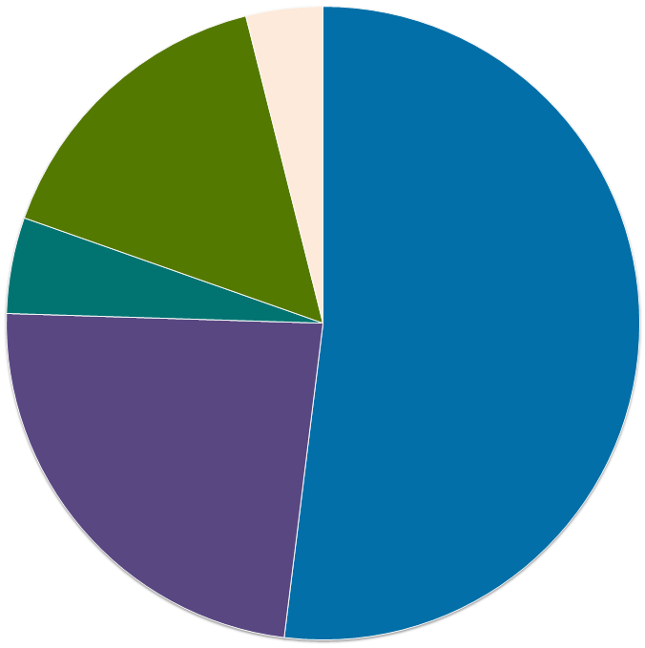
Volume of funding according to support area (2016)*
€20
million
4%
Mitigating greenhouse gas emissions
€80 million
16%
Adapting to the impacts of climate change
€25 million
5%
€265 million
52%
Conserving natural carbon sinks/REDD+
€120 million
23%
Conserving biological diversity
Administrative costs
*Doha accounting
As of: May 2017
Notes:
As of May 017
In 2016, a funding volume of
EUR 265 million was approved in the category of mitigation.
EUR 120 million was approved in the category of adaptation.
EUR 25 million was approved in the category of REDD+.
EUR 80 million was approved in the category of biological diversity.
Only use in response to questions!
Difference between commitment-based accounting and Doha accounting
Commitment = fiscally binding, pledged funding amount in a certain year.
The following are counted as commitments:
Total budgetary volume of an approved/commissioned project in the annual commitment period.
Bilateral IKI projects.
Doha (expenditure) accounting
Goal: to more clearly emphasise the importance of the EKF
The following are counted as expenditures:
Bilateral EKF projects
Multilateral contributions
The commitment-based accounting system is not shown in the figure.
This results in the following according to distribution (for 2016):
B I Mitigating greenhouse gas emissions EUR 224 million (23 new projects; 29 projects with increase of funding volume)
B II Adapting to the impacts of climate change EUR 112 million (11 new projects; 8 projects with increase of funding volume)
B III Conserving natural carbon sinks/REDD+ EUR 24 million; (9 new projects; 2 projects with increase of funding volume)
B IV Conserving biological diversity EUR 44 million (10 news projects; 4 projects with increase of funding volume)

Slide 10
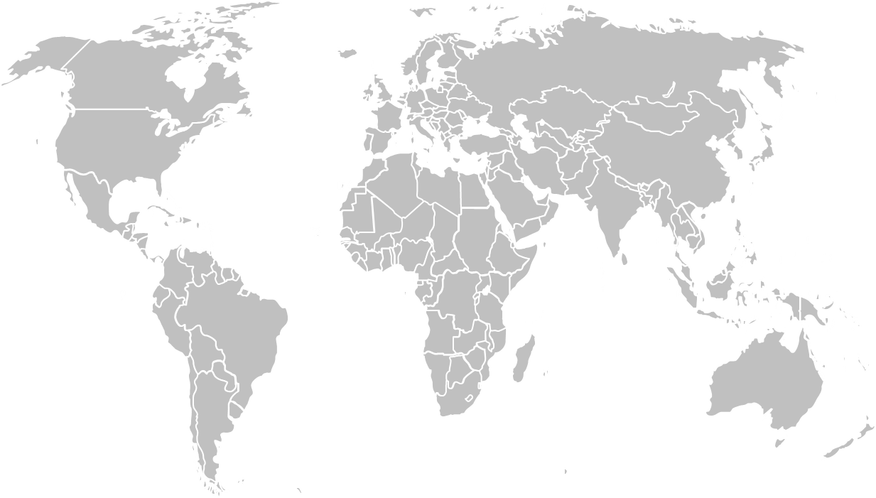
Level of IKI support according to region
(2008-2016, in € million)*
158
Europe, Caucasus, Central Asia, Turkey
1032
Global
77
MENA
(Middle East and Noth Africa)
377
179
South and
South-East Asia, Pacific
373
Sub-Saharan
Africa
Central and South America, Caribbean
*Doha accounting
without administrative costs
As of: March 2017
Notes:
The ‘global’ category includes projects that demonstrate a global or supra-regional focus and cannot be classified within any specific region. Projects spanning multiple countries within one region are categorised within that region.
The figures given here include funding from the German Climate Technology Initiative (DKTI), the NAMA Facility as well as payments made to multilateral funds.

Slide 11
Level of IKI support according to region
(2016, in € million)*
6
Europe, Caucasus, Central Asia, Turkey
293
12
Global
MENA
(Middle East and Noth Africa)
52
35
South and
South-East Asia, Pacific
Sub-
Saharan
Africa
90
Central and South America, Caribbean
*Doha accounting
without administrative costs
As of: May 2017
Notes:
The ‘global’ category includes projects that demonstrate a global or supra-regional focus and cannot be classified within any specific region. Projects spanning multiple countries within one region are categorised within that region.
The figures given here include funding from the German Climate Technology Initiative (DKTI), the NAMA Facility as well as payments made to multilateral funds.

Slide 12
Recent Changes in IKI
More focus on NDCs
Larger, more integrated projects
More opportunities for partner countries to voice their needs

Slide 13
The International Climate Initiative (IKI) Flagship Projects

Slide 14
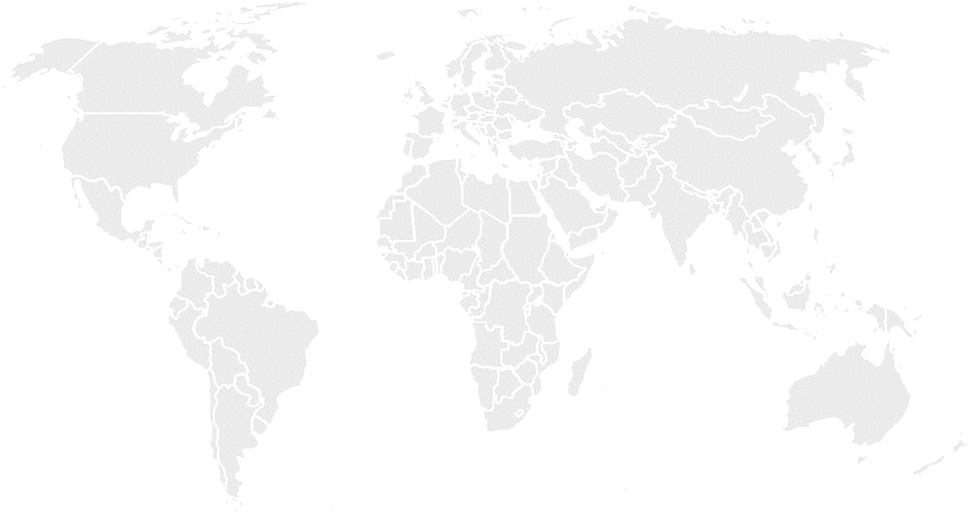
IKI portfolio in Urban Development
81 Projects in urban areas with a funding totalling EUR 306 Mio.
22 projects with funding totalling EUR 78 Mio. focusing particularly on “urban development and urban governance issues”
Notes:
Urban focus only since 2015 -> in line with Paris Agreement and New Urban Agenda → most projects are just starting now

Slide 15
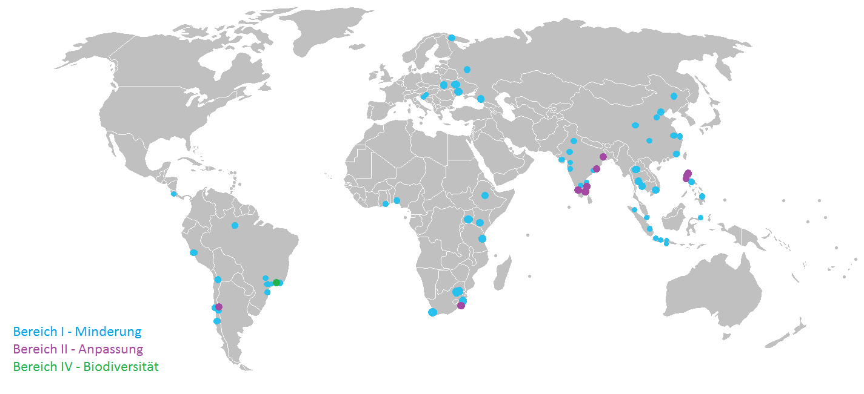
IKI activities in cities
Murmansk
Kiew
Moskau
Pingliang
Lviv (3)
Visakhapatnam (2)
Harbin
Krapina
Odessa
Sotchi
Peking (3)
Zagreb (2)
Shijiazhuang
Shanghai
Neu Delhi (3)
Jiangsu (3)
Yuzhong
Udaipur
Howrah
Nanjing
San Ferndando La Union
Rajkot
Xiamen
Nashik
Pune
Nan
Shenzen
Mumbai
Chennai (2)
Dagupan
Tuguegarao
San José
Lagos
Addis Abeba
Cochin
Madurai
Manila (1)
Accra (2)
Kasese
Bangalore
Baguio
Cali (2)
Klaeng
Manaus
Kampala
Bangkok
Nairobi (2)
Manado (3)
Dar es Salaam
Medan (3)
Ho Chi Minh (Saigon)
Lima (3/1)
Batam (3)
Votuporanga
Tshwane/ Pretoria (2)
Palembang
Makassar
Calama
Duque de Caixas
Jakarta (2)
Surakarta
Americana
Rio de Janeiro
Johannesburg (3)
Pangandaran
Santiago (3)
Jundiaí
Yogyakarta
Valparaiso
Florianopolis (3)
eThekwini/
Durban (2)
Buin
Kapstadt
Concepcion
mitigation activities adaptation activities biodiversity activities
Projects in progress or finalised
(number of IKI projects)
as of: October 2017

Slide 16
Notes:
Large pipeline of new IKI Projects coming
Cities fit for climate change
Urban Pathways
Focus on Finance, Felicity MEX, BRA and CHN
Focus on Smart Cities, ICT based adaptation.
Urban Partnerships, CHN, BRA, IND
Change in IKI Process will also change urbanisation cluster – More opporuntity to merge capacity building with actual finance on the ground.

Slide 17
Thank you for your attention!
www.international-climate-initiative.com
E-Mail: hermann.amecke@bmub.bund.de
@iki_bmub

Slide 18
