Slide 1
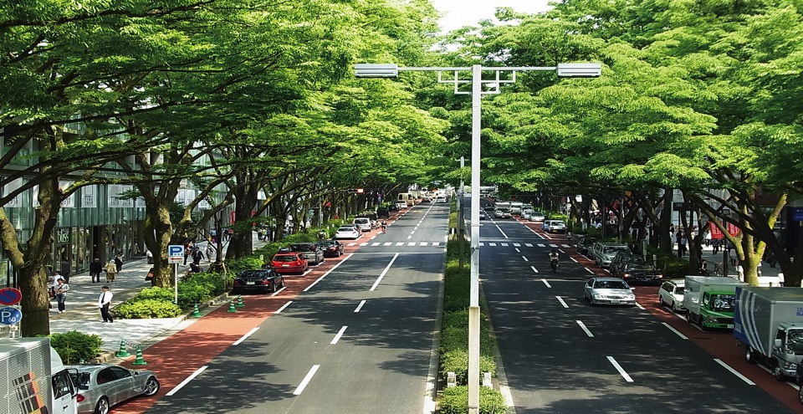
Implementing of Sustainable Mobility Solutions : the next step for Kochi

Slide 2
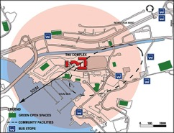
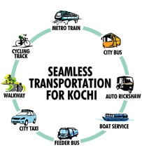
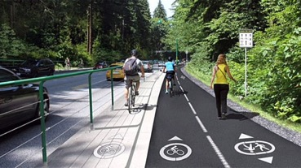
SIX Pillars of Integrated Public Transport
Within 500 m
Truly integrated network
First/Last mile connectivity through waking & cycling

Slide 3
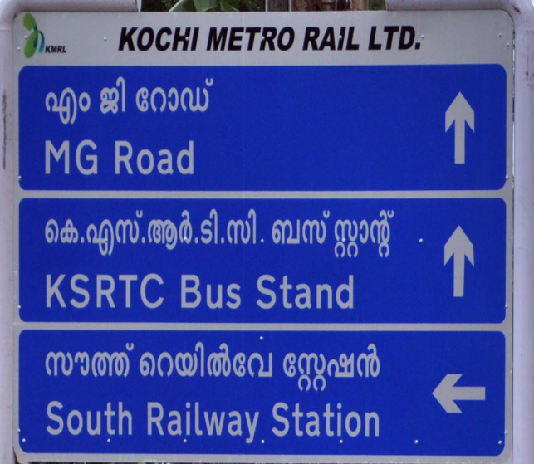
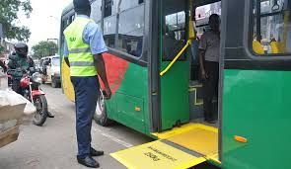
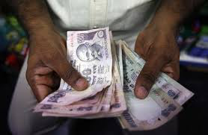
SIX Pillars of Integrated Public Transport
Understandable to all, with clear information (Timetable, Directions)
Accessible for people of all age groups and all physical conditions.
Accessible to all income groups

Slide 4
To have foundation of six pillars……
Kochi requires integration at 4 levels…...
Institutional level
Physical Level
Information Technology Level
Fare Level
Metropolitan Transport Authority (MTA)- Kochi
MRTS, Passenger/Logistics hubs, Interchange points, NMT
ITS, Mobile App, Journey Planner, Display units, Kiosks, OCC, Adaptive Signaling, AFC,
Smart Card Ticketing, Telescopic fare structure & Automatic fare revision mechanism

Slide 5
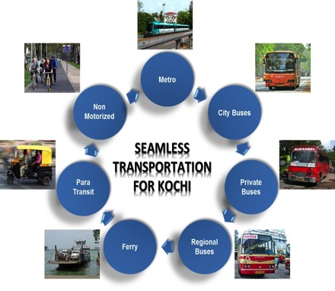
Metropolitan transport authority-Kochi
Metropolitan Transport Authority (MTA) will be as Single agency responsible for planning, coordination, integration, management and regulation of Kochi’s transit system, with following key functions:
Policy Formulation
Strategic Planning & Programming
Project Preparation
Project Implementation
Standard Settings
Regulatory Functions
Financing Functions
A Draft Act for the MTA is expected to be before the next legislative assembly.
Presently MTA-Kochi is operating under a Government Order of 2013 & KMRL as an Interim MTA.
MTA will be mandated to raise local resources and spend locally on improving Kochi’s urban transport.

Slide 6
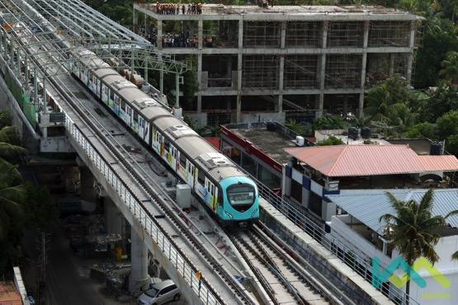
Mass Transit Systems - Kochi Metro Rail (2013-19)
Kerala’s first mass rapid transit system
High Capacity
25 km section of the line from;
MG Road - Aluva
MG Road – Petta (Extn up to S.N.Jn)

Slide 7
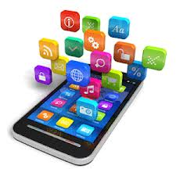
‘INFORMATION TECHNOLOGY INTEGRATION’
Station Information
Plan Journey
Information
Alerts
Book Tickets
Mobility App
Shopping
Tourist Info
Live Status
Login

Slide 8
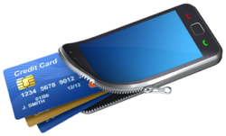
“FARE INTEGRATION” EMV-COMMON SMART CARD TICKETING (RuPay Card)
Connected Wallet

Slide 9
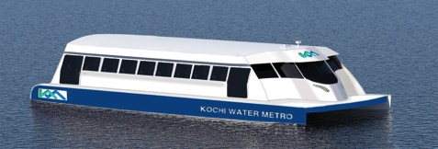
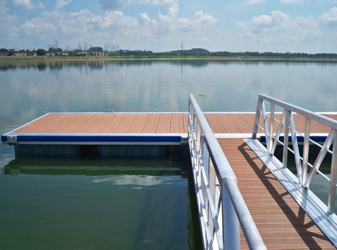
Mass Transit Systems - Water Metro (2017-2020)

Slide 10
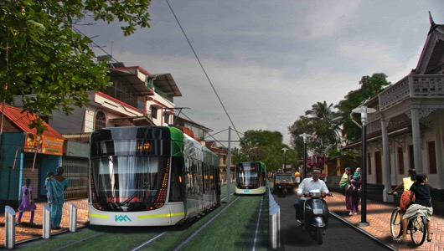
Mass Transit Systems - ALTERNATIVES (UNDER CONSIDERATION ) Bus Rapid Transit (BRT)
High-quality bus-based transit system that delivers fast, comfortable, and cost-effective services at metro-level capacities.
Light Rail Transit (LRT)
LRT is an at grade, rail based MRTS on a dedicated guide way.

Slide 11
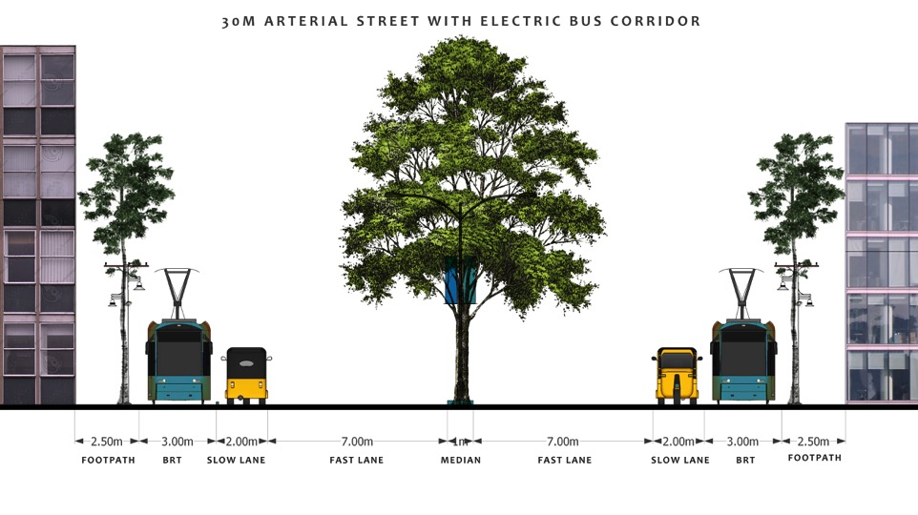
Mass Transit Systems – ALTERNATIVES electRic Bus Rapid Transit [curb/median]

Slide 12
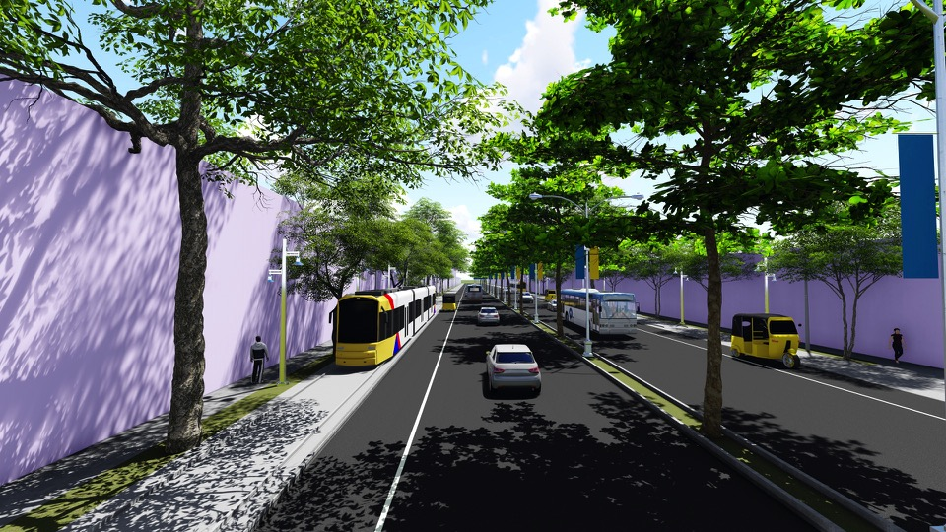
Mass Transit Systems – ALTERNATIVES Bus PRIORITY Transit (BPT on 30m RoW street)

Slide 13
Non motorised transport- WalkwayS & CyclEs

Slide 14
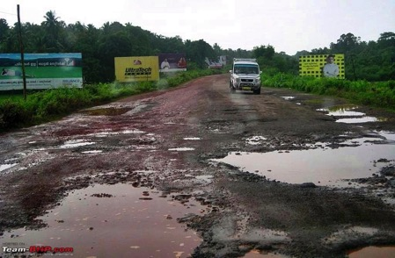
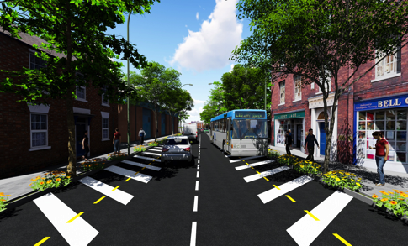
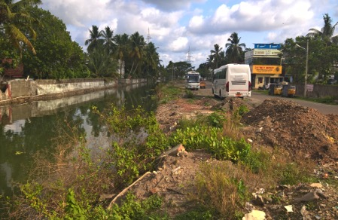
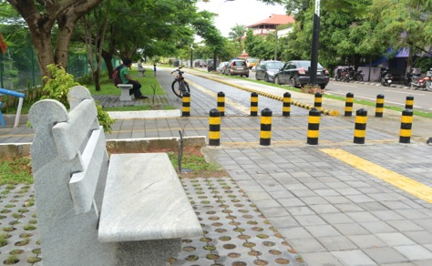
Goal(1): ROAD TO STREET
PANAMPILLY NAGAR-KOCHI, EARLIER & TODAY

Slide 15
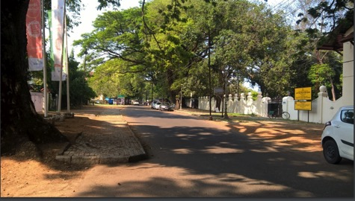
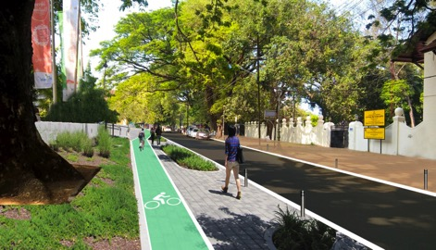
Goal(1): ROAD TO STREET
Now
Desired

Slide 16
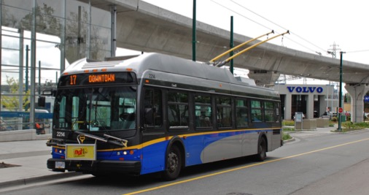
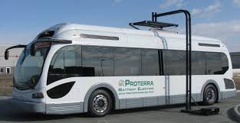
Goal(2): CARBON FUEL TO ELECTRIC MOBILITY

Slide 17
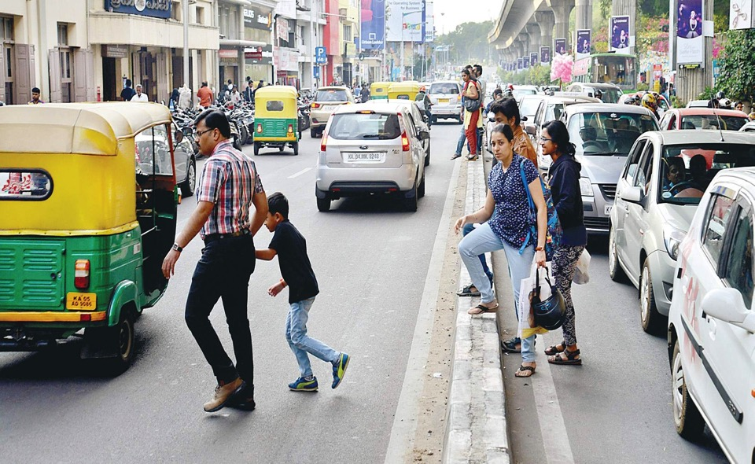
Today - vehicles first, Pedestrians next….
M.G.Road, Bangalore

Slide 18
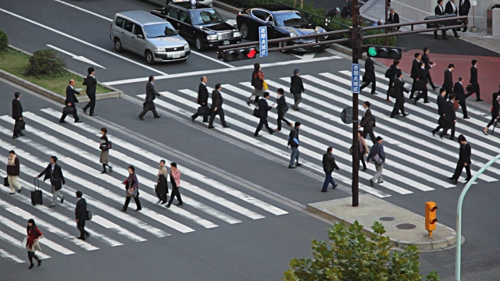
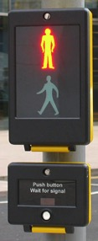
Pedestrians first, vehicles next……

Slide 19
MODE SHARE OF TRANSPORT IN GREATER KOCHI-2015
VEHICLE SHARE (94% + 6% others) | PASSENGER SHARE (100% + 0% others) | INTENT
4 % | 49% (Declines 3% year)
11% | 8%
27% | 12%
52% | 31%

Slide 20
Goal(5): ENABLE TECHONOLY, save earth & rEvive city
Restoration of Cheong-gye-cheon river,Seol,south korea

Slide 21
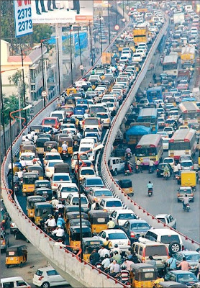
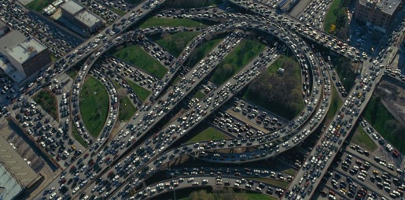
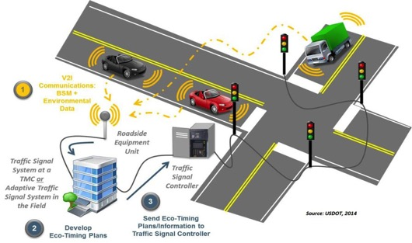
Goal(5): ENABLE TECHONOLOGY, replace structures
ADAPTIVE SIGNALLING SYSTEM (ITS)

Slide 22
WE ARE PLANNING A HOLISTIC APPROACH, LET US……
Encourage mode shift from personalized transport to Public Transport,
Recreate urban fabric, vibrant & green
Reduce the noise and air pollution levels,
Encourage Electric vehicles.
MAKE THE CITY MORE LIVEABLE!

Slide 23
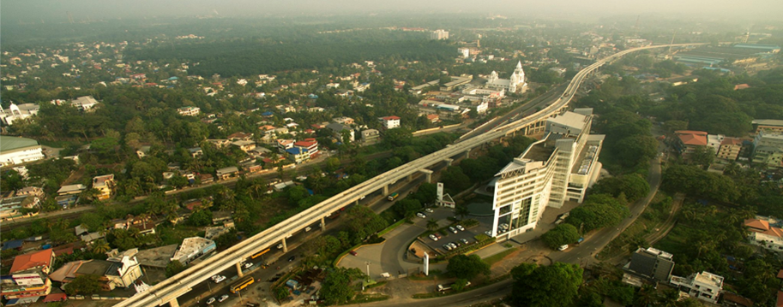
ONE NETWORK, ONE TIMETABLE, ONE FARE….. FOR GREATER KOCHI
THANK YOU…
Dr. Rajan Chedambath
Director
Centre for Heritage, Environment and Development

