Slide 1
Launch of the Urban Pathways project
Supporting Low Carbon Plans for Urban Basic Services in the context of the New Urban Agenda

Slide 2
Implementing Partners
Funded by the German Ministry for the Environment
Delivered in a partnership with UN-Habitat, the Wuppertal Institute and UN Environment

Slide 3
About
Urban Pathways

Slide 4
Focus areas
The project will take an integrated approach and will focus on the climate change mitigation relevant urban basic services, in the areas of urban energy, mobility and waste management

Slide 5
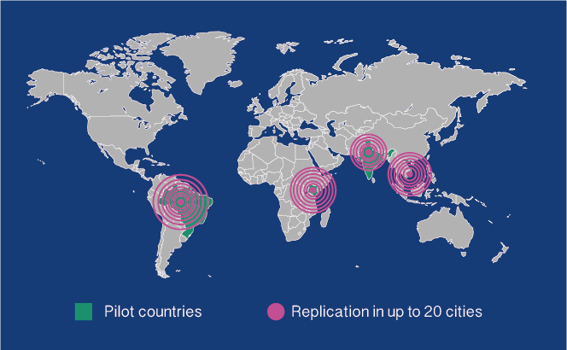
Pilot countries
Brazil
India
Vietnam
Kenya

Slide 6
Replication countries
Nepal
Bhutan
Fiji
Malaysia
Zambia
Mexico
Ukraine
South Africa
Bangladesh
Kazakhstan
Indonesia
…

Slide 7
Key actions
Develop national action plans and concrete local implementation concepts to boost low-carbon urban development in key emerging economies - India, Brazil, Kenya and Viet Nam
Make an active contribution to achieve global climate change targets to a 1.5 Degree stabilisation pathway by unlocking the global emission reduction potential of urban energy, transport and resource sectors of 3.7Gt CO2 emissions by 2030
Establish a program in close cooperation with other organisations and networks active in this area to support national and local governments

Slide 8
Action plans
The plans will include an assessment of:
political, technological, socio-economic and financial viability
The local implementation concepts will be:
developed into bankable projects, focusing on the access to urban basic services to create a direct link between climate change mitigation and sustainable development goals
This process will be:
replicated regionally with policy development and implementation support
and advice on stakeholder engagement and financing mechanisms ​

Slide 9
About
Urban Pathways

Slide 10
Factsheets about the mitigation and sustainable development potential
Guidelines on the implementation of low-carbon urban development solutions
Urban implementation action tracker
Conferences, trainings, workshops and meetings
Projects guidelines, reports and policy advice papers

Slide 11
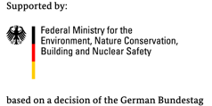
About
Urban Pathways

Slide 12
City officials, young professionals, urban development practitioners and NGOs participate in the project´s capacity building and eLearning Urban Change Maker programme
Stakeholders institutions will participate in local, regional and international knowledge sharing and training events

Slide 13
About
Urban Pathways

Slide 14
Policy and strategy papers for local and national authorities
Mainstream the New Urban Agenda into local and national urban policies
Development of project concepts and implementation plans
Set-up City twinning partnerships to facilitate exchange among the pilot and replication cities

Slide 15
Project concepts and implementation plans
Proof of concept projects
> 5.000 Euro
Pilot Projects
> 50.000 Euro
Large Scale Project Bankable Projects
> 5.000.000 Euro

Slide 16
About
Urban Pathways

Slide 17
Feasibility studies and implementation plans for 4 pilot cities (incl. bankable projects)
Identify appropriate funding solutions and facilitate the dialogue with relevant funding agencies
Political and institutional framework analysed for pilot cities and provision of policy process to support the implementation.

Slide 18
Join us!
www.urban-pathways.org

