Slide 1
City of Cape Town New Urban Agenda
Vijandren Naidoo
Sustainable Energy Markets
17 October 2017

Slide 2
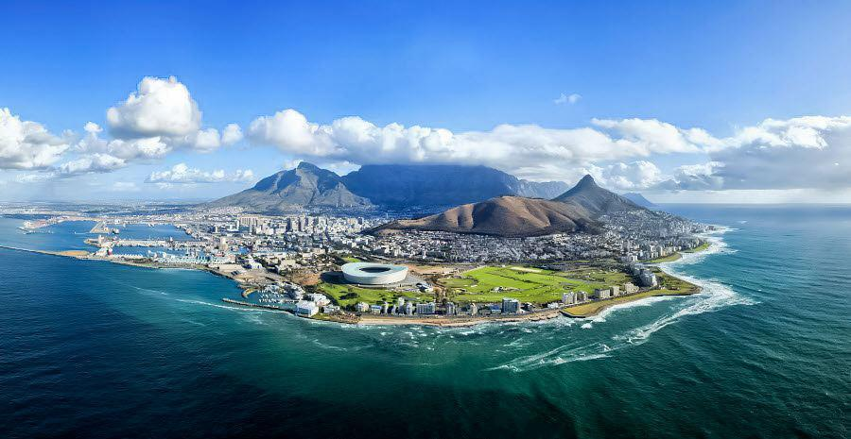

Slide 3
Presentation Outline
Integrated Development Plan
Cape Town Energy 2040 Vision
Energy in Electricity
Energy in Transport
Challenges faced

Slide 4
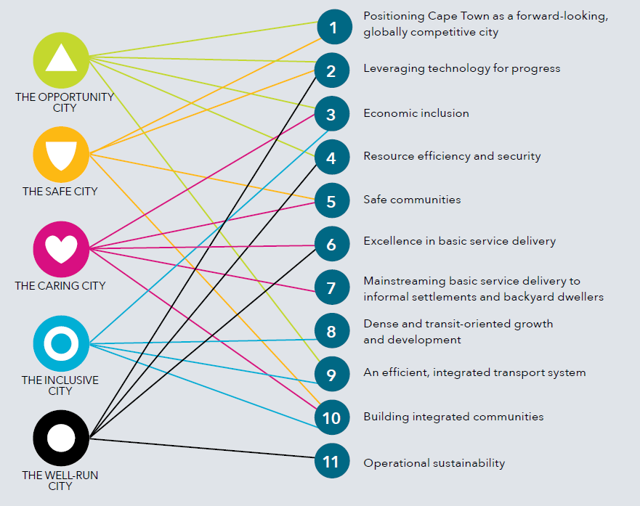
Integrated Development Plan

Slide 5
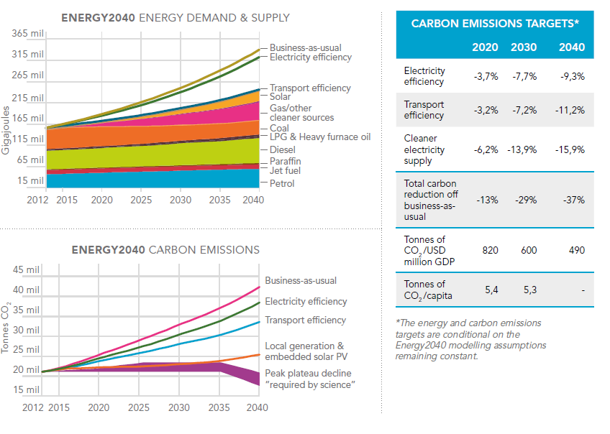
Cape Town Energy 2040

Slide 6
Energy: Electricity
City procures power mainly from Eskom (1.8 GW of capacity mainly coal)
Approximately 3.6% of the Eskom power procured is from Renewable Energy Resources
Largest uptake of renewable is in Solar PV installations
Rising electricity prices
Lower PV costs
IPP procurement process is fraught with regulatory and policy issues
Clarity required for large scale renewable energy procurement

Slide 7
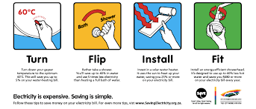
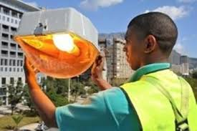
Energy Efficiency
Energy Efficiency
Energy efficiency initiatives implemented in many buildings & facilities
Replaced street lighting and traffic lights
Smart meters being installed
Strategy to rollout to other departments (solid waste, waste water, etc.)
Promotion, awareness and education in private sector
Rollout of Solar Water heating and heat pumps through accredited installers
Low Income energy services

Slide 8
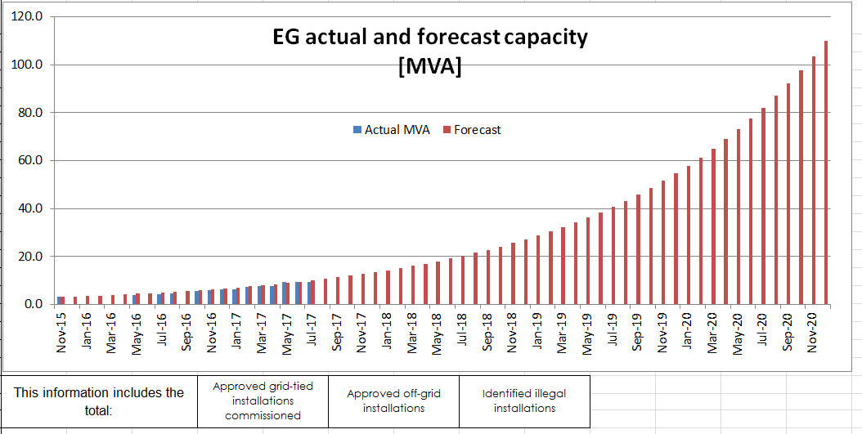
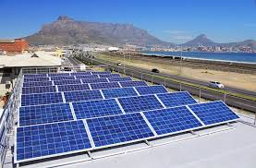
Renewable Energy
Solar
Independent Power Producers
Small Scale Embedded Generation
City Owned PV
Hydro
Micro-hydro’s at waste water plants
Wind
Darling wind farm

Slide 9
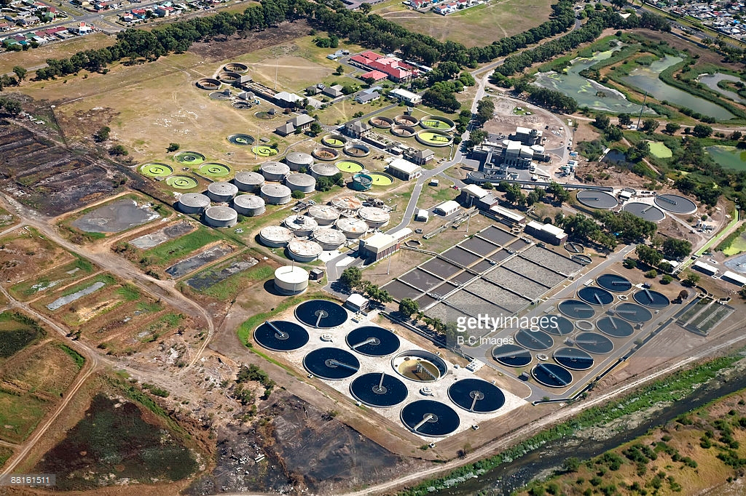
Waste to Energy
Waste Water
Primary sludge waste is treated in bio-digesters
Planned installation of CHP plant (1.7MW)
Key water sites are being assessed
Solar PV installation feasibility assessments
Solid Waste

Slide 10
Energy 2040
2017
Low carbon
Energy Security
Resource Efficiency
Revenue Protection
Job Creation
2020 _{(IDP 2017)}
120 MW SSEG
100MW RE
300 MW Gas / Clean Energy

Slide 11
Approach to achieving target

Slide 12
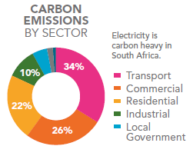
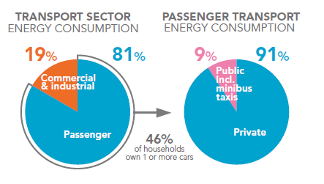
Energy: Transport

Slide 13
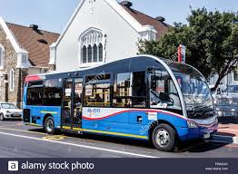
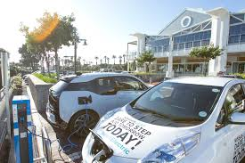
Reducing the transport footprint
Transit Orientated development
Strategy in place
Extend coverage of public transport
New economic development zones
E-Mobility
Development of EV framework
Include EV’s in fleet
Work on developing infrastructure
Electric bus fleet rollout in 2018 (PV for charging)
Improve bicycle lanes
Electric bikes, scooters

Slide 14
Challenges faced by City of Cape Town
Drought crisis
Regulatory challenges
Internal resources
Revenue risk
Technical risks
Socio-economic development

Slide 15
For queries contact vijandren.naidoo@capetown.gov.za

