Slide 1
Towards A Balanced Approach To Sustainable Urban Development In Bhutan

Slide 2
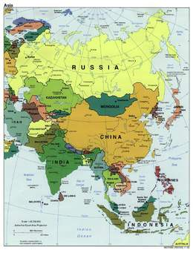
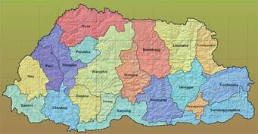
Glimpse about Bhutan

Slide 3
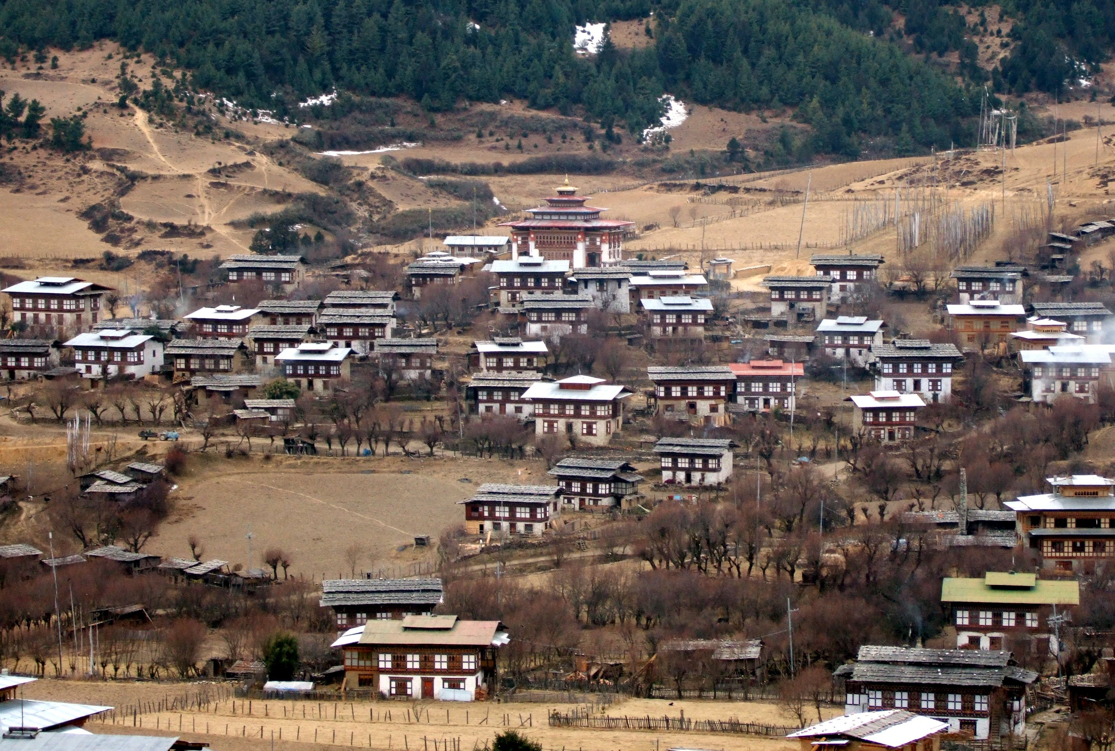
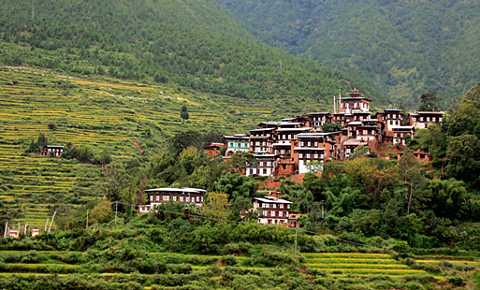
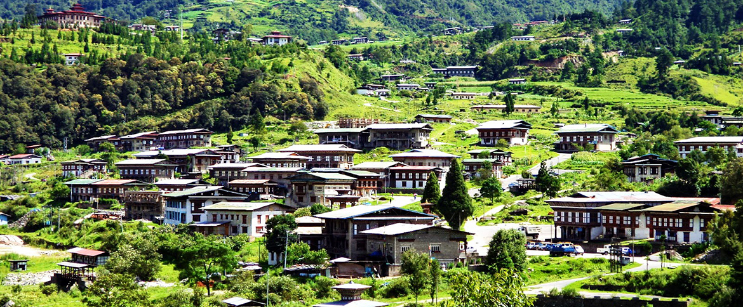
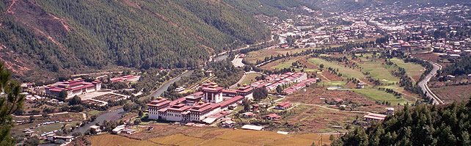
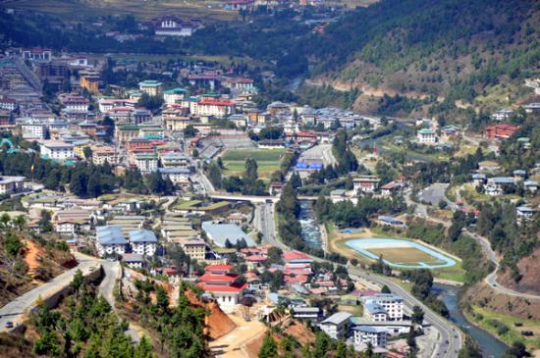
Glimpse about Bhutan
RURAL AND URBAN SETTLEMENT

Slide 4
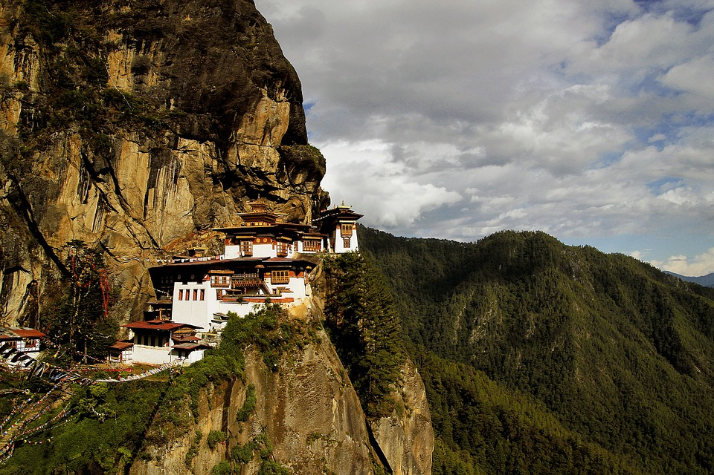
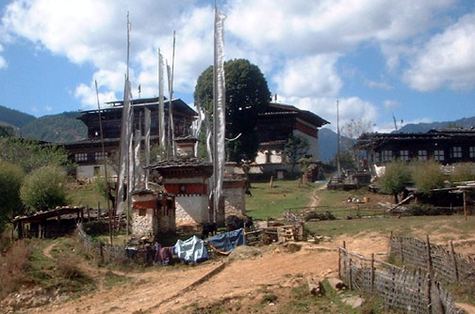
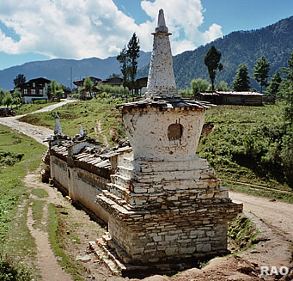
Glimpse about Bhutan
Architecture

Slide 5
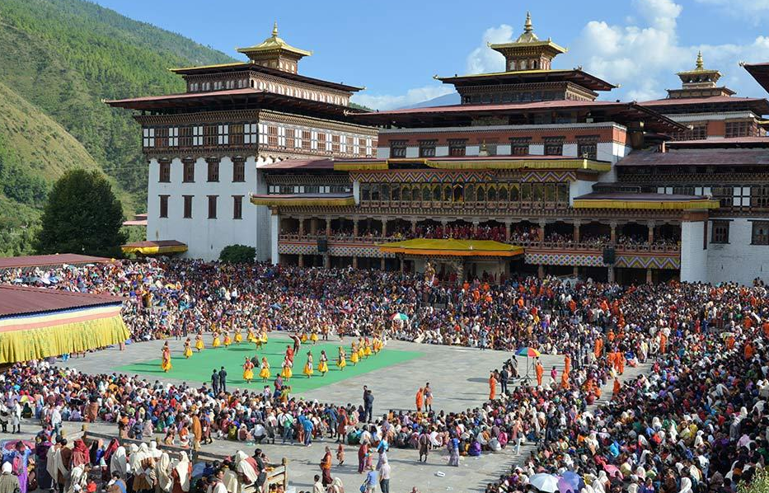
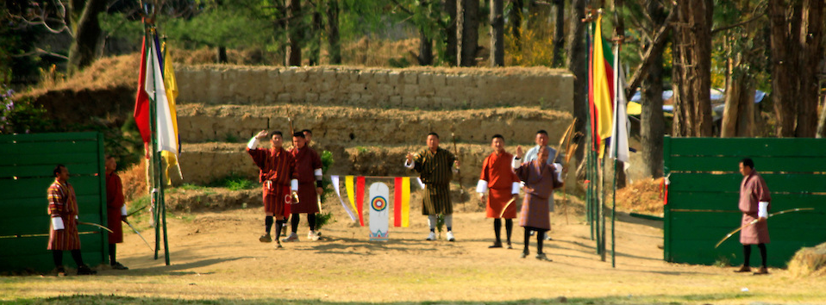
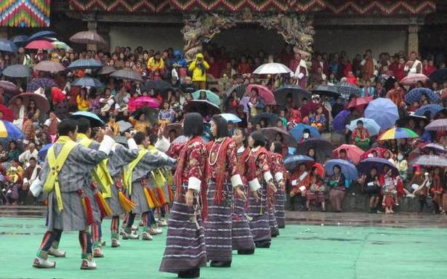
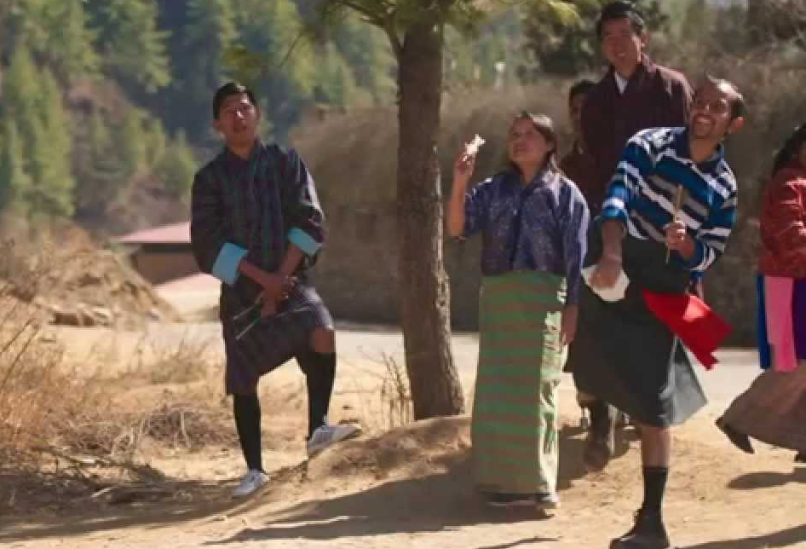
Glimpse about Bhutan
Culture

Slide 6
INTRODUCTION
BHUTAN has an area of 38,394 square kilometers located in eastern Himalayas, surrounded by China in the North and South by India.
Elevation ranges from 200 to 7000 meters resulting in diverse climatic conditions and biodiversity.
Administratively the country is divided into 20 districts and 205 blocks
Population and Housing Census of Bhutan (PHCB) Bhutan has population increased from 634,982 in 2005 to 757,042 in 2015
Bhutan is going through the 11th five year plan period which started in 1961
Today 30% of population lives in towns as against 15% in 1999
In terms of urbanization 65% of population lives in western region while only 18% in the eastern region
Bhutan has 4 major cities/towns and 20 satellite municipalities

Slide 7
Towards a Balanced Approach to Sustainable Urban Development
Basic Facts
56% of Bhutan’s population are agriculturist accounting for 16.8% of GDP.
Country’s fragile ecology and geography - a challenge to urbanization
Bhutan has urbanized 31% with sharp regional disparity in terms of settlement
Current urbanization growth is 7.3% as compared to 1.28% for total population. West by 11%
Given the harsh geo-physical conditions the spatial study shows that land occupied currently for settlement is about 1% of the total 38,394 square kms

Slide 8
Towards a Balanced Approach to Sus Urban Development
Objectives
To balance Rapid Urbanization with Preservation of country’s Fragile Eco-system; - the Bhutan National Urbanization Strategy (BNUS) was adopted in 2008. The BNUS:
Promotes different types of settlements with an integrated approach to planning and development. The BNUS :
Ensures Preservation of Environment, Tradition, Culture and its Sacred structures, unique Architecture, and conservation of Ecology
Mandates Safe and Disaster Resilient Settlements - with housing for all
Identifies potential settlement areas – Land, Connectivity & access, Water availability the Protected and Restricted / Sensitive areas
Recommends supporting Policies, Institutional and Regulatory frameworks to implement the National Human Settlement Policy (NHSP)

Slide 9
Towards a Balanced Approach to Sustainable Urban Development
Guiding Principles:
The GNH principles that seek for a balanced approach to enhancing Economic development, Environment conservation, Cultural preservation and good Governance
The concept of regionally balanced and equitable development with emphasis of population growth and movement (NHSP)
Disaster Risk Reduction and Management Policy. Bhutan susceptible to GLOF, Floods, Landslides and seismic hazards.
Mainstream X-cutting issues on Gender, Special needs, Poverty, Environment and Climate change
Relevant to Prevailing and Emerging development Trends and Issues

Slide 10
Climate Impact Issues and Challenges:
Impacts of Climate Change

Slide 11
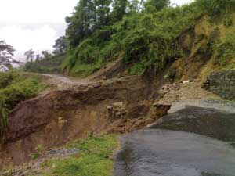
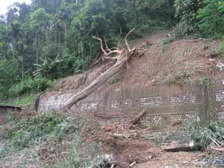
Climate Impact Issues & Challenges
Impacts of Climate Change
- Drying of Water sources e.g, Mongar & Damphu in Tsirang (are severely hit).
- Land slides, Flash floods and storms because of intense and extreme weather events.

Slide 12
Policies and Strategies Towards a balanced approach to sustainable urban development
Bhutan Vision Doc 2020: A Vision for Peace, Prosperity and Happiness.
Strategy for Gross National Happiness 2010.
National Human Settlement Policy (NHSP)
Comprehensive National Development Plan (CNDP - Under preparation)
Bhutan National Urbanization Strategy (BNUS 2008).
National Human Settlement Strategy.
….all these policies aim to promote Settlements that are Environmentally Sustainable, Culturally Vibrant, Economically Strong, and Highly Livable.

Slide 13
National Human Settlement Policy (NHSP)
Of the few Policies the NHSP, broadly covers both Urban and Rural settlements. And it was envisaged that by 2020, Bhutan would be 50% Urbanized
Vision
Development of Highly Live-able Human Settlement
Mission
To provide a framework for Planning and Development of Environmentally Sustainable, Culturally and Economically vibrant and Disaster Resilient Human Settlements.

Slide 14
Towards a Balanced Approach to Sustainable Urban Development
Strategy to Balance Urbanization
Human Settlement Strategy to focus on Regional Growth Policy.
- The Bhutan National Urbanization Strategy (BNUS)
Policies therefore adopted to respond to economic compulsion that give rise to rapid rural-urban migration
Focus on expansion of existing centers vice creation of new & provide basic live-able requirements
BNUS looks into improving quality of urban design and planning – with critical focus on comprehensive land use for provision of infrastructural amenities

Slide 15
Continued – Strategy to balanced Urbanization
Specific regulations to capture Peri-urban and Semi-urban areas which are fast transitioning from rural to urban character
[generally the fast growing areas –do not get adequate basic amenities and services such as water supply, electricity and road accessibility let alone the more urban comforts of leisure spaces, pedestrian walkways, differently abled needs]
Put in place (where necessary) / adopt available (if any) legislation and national strategies
Strengthen institutional and legal framework for promotion of inclusive and participatory system of planning and development of a live-able human settlements

Slide 16
To address Rural –Urban Migration, Efforts are made by agencies to provide basic infrastructure and associated services in rural settlements
Education and Health infrastructure taken closer to rural population; Rural Connectivity enhanced
To allow income generation efforts were made to modernize the agriculture and horticultural sector
In terms of settlement Bhutan declared autonomous municipalities and satellite towns in each of twenty districts
Two Regional Hubs – address issues of R-U migration

Slide 17
Bhutan National Urbanization Strategies (BNUS -2008)
Balanced Regional Development by identifying regional growth centers in the eastern and central regions of the country.
Rural-Urban Integration.
National Urban System: Hierarchy of urban settlements forming spatial framework through network of cities, towns and village centers.
Financial priorities to the regional centers.

Slide 18
BNUS 2008…contd
Enforcement of Environmental Protection Policies.
(Benefits of Farmers and Communities are not compromised)
Preservation of Culture and Heritage.
(Two towns viz Bumtha and Trashi Yangtse to be
maintained as Unique Heritage towns)
Institutionalizing Community Participation in Urban Planning and Development.
Institutional and Capacity Building.

Slide 19
INTERVENTIONS: Legislations Towards a balanced approach to sustainable urban development
Thromde (Municipality) as a Local Government by Local Government Act 2009.
Declaration of 20 District Municipalities and 20 Satellite towns.
Municipal Finance Policy in place to improve financial autonomy of the Municipalities.

Slide 20
Contd…INTERVENTIONS: Legislations Towards a balanced approach to sustainable urban development
Spatial Planning Act completed and is due for submission to Cabinet for endorsement and for onward submission to Parliament.
Mandatory requirement to carry out SEA (Strategic Environmental Assessment) and EIA (Environmental Impact Assessment) for major projects.
Low Emission Development Strategy for Urban and Rural Areas of Bhutan

Slide 21
Contd…INTERVENTIONS: Legislations Towards a balanced approach to sustainable urban development
Revision of Land Pooling/Land Readjustment Regulations to address the emerging trends of urban planning and its implementation completed.
Revision of Building Regulations completed.

Slide 22
INTERVENTIONS: Planning & Development Towards a balanced approach to sustainable urban development
Three Tier Spatial Planning Frame Work: National, Regional and Local Spatial Plans.
Incentives for Protected Zones issued as Directives by the Government to implement areas such as
river buffer, open spaces, Environmentally Sensitive areas, buffer for culture and heritage structures etc identified in the urban development plans.

Slide 23
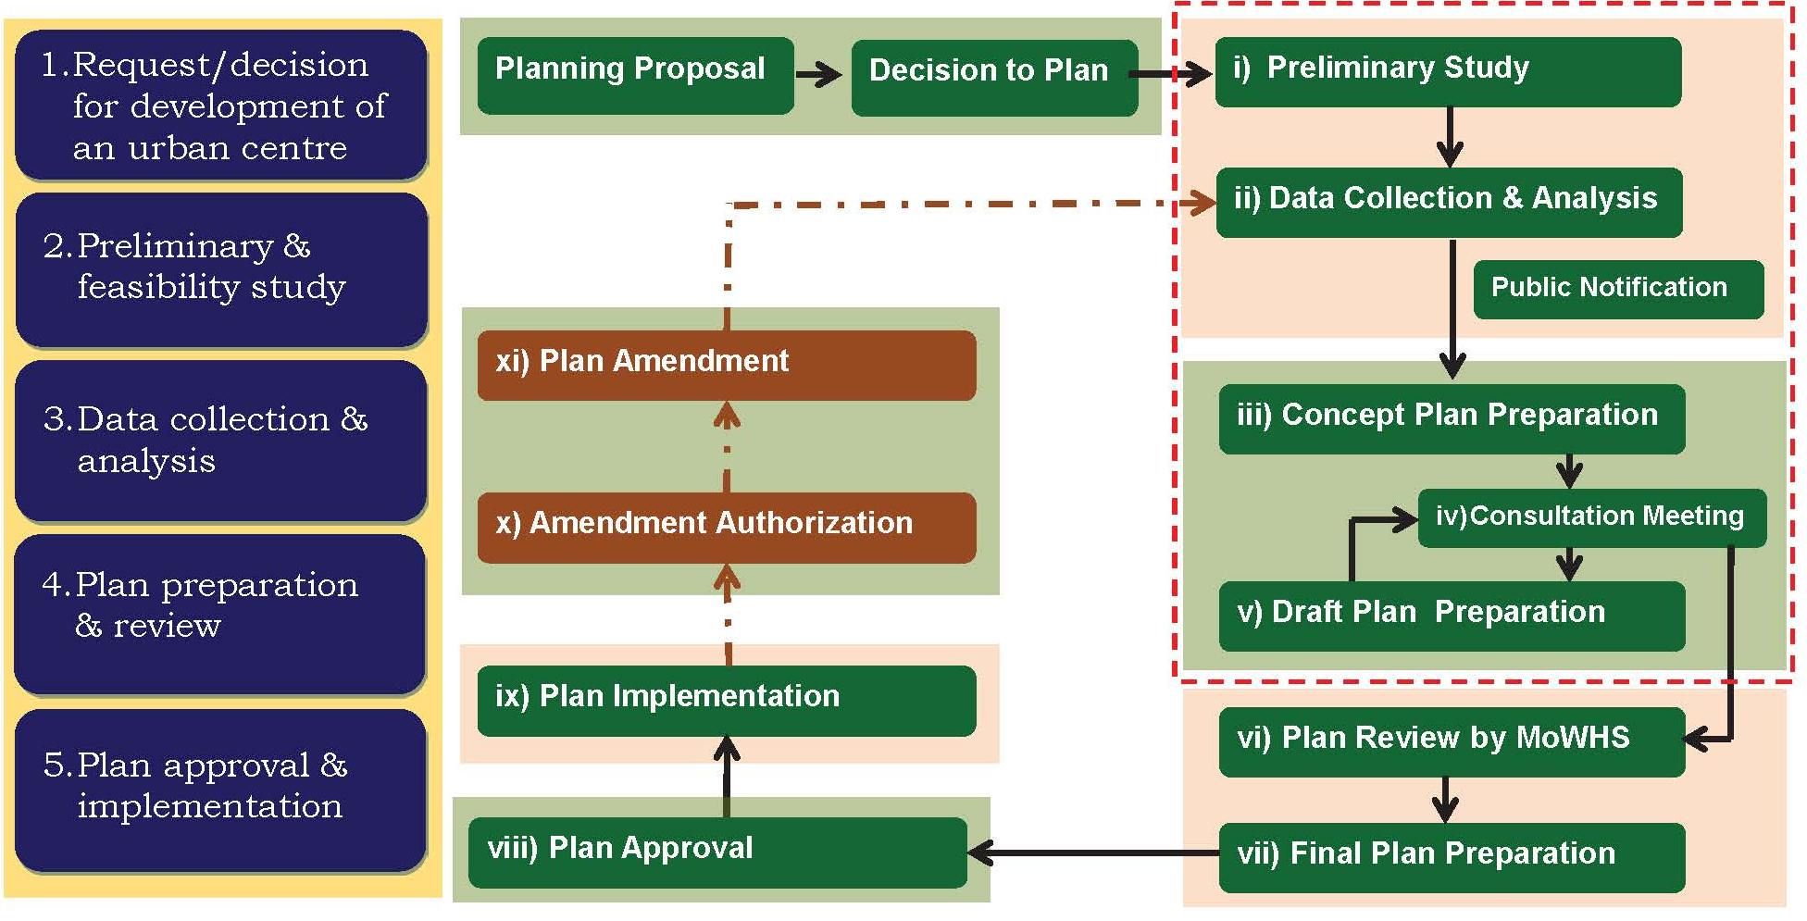
Contd…INTERVENTIONS: Planning & Development Towards a balanced approach to sustainable urban development
Establishment of Planning Process to ensure proper planning and informed decision making.

Slide 24
Contd…INTERVENTIONS: Planning & Development Towards a balanced approach to sustainable urban development
Preparation of TWO Valley Development Plans integrating Rural and Urban Areas which are under implementation.
(Sharing of resources and facilitating rural and urban authorities to work together)
Two Regional Hubs (Education hub in East and Commercial Hub in central South)

Slide 25
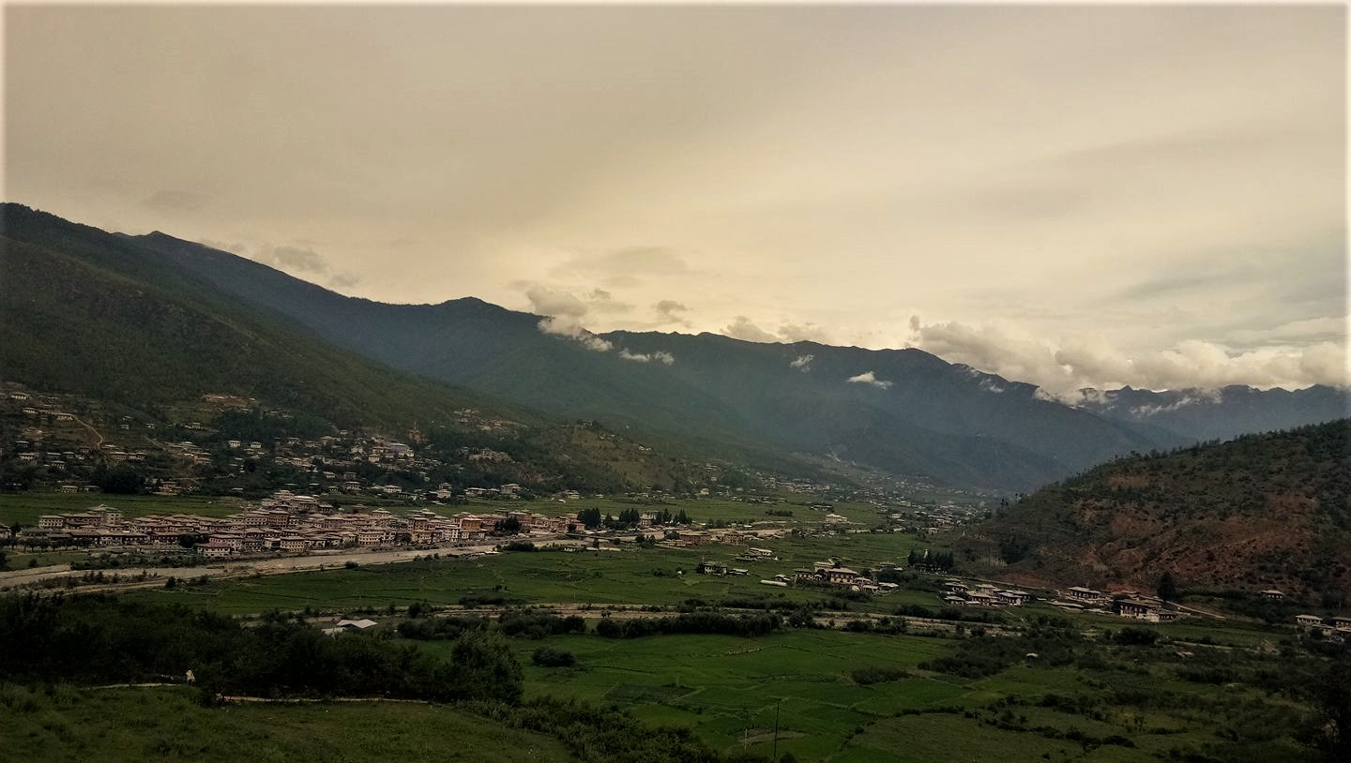
Paro Valley Development Plan Towards a balanced approach to sustainable urban development
PARO VALLEY
URBAN PARO
RURAL PARO

Slide 26
Land Pooling Towards a balanced approach to sustainable urban development
An Approach – facilitating the stakeholders and affected Landed Property Owners to Participate and own the Preparation of their Local Area Plans
Percentage of property contribution range from 15 to 30 percent. Beyond this was found technically inefficient
Allows spaces for provision of common basic amenities such as water supply, power & sewer lines, building set backs for logistical and emergency accessibility - for firefighters during fire accidents

Slide 27
Towards a balanced approach to sustainable urban development Planning with Land Pooling/Readjustment

Slide 28
Towards a balanced approach to sustainable urban development (Planning with Land Pooling/Readjustment)

Slide 29
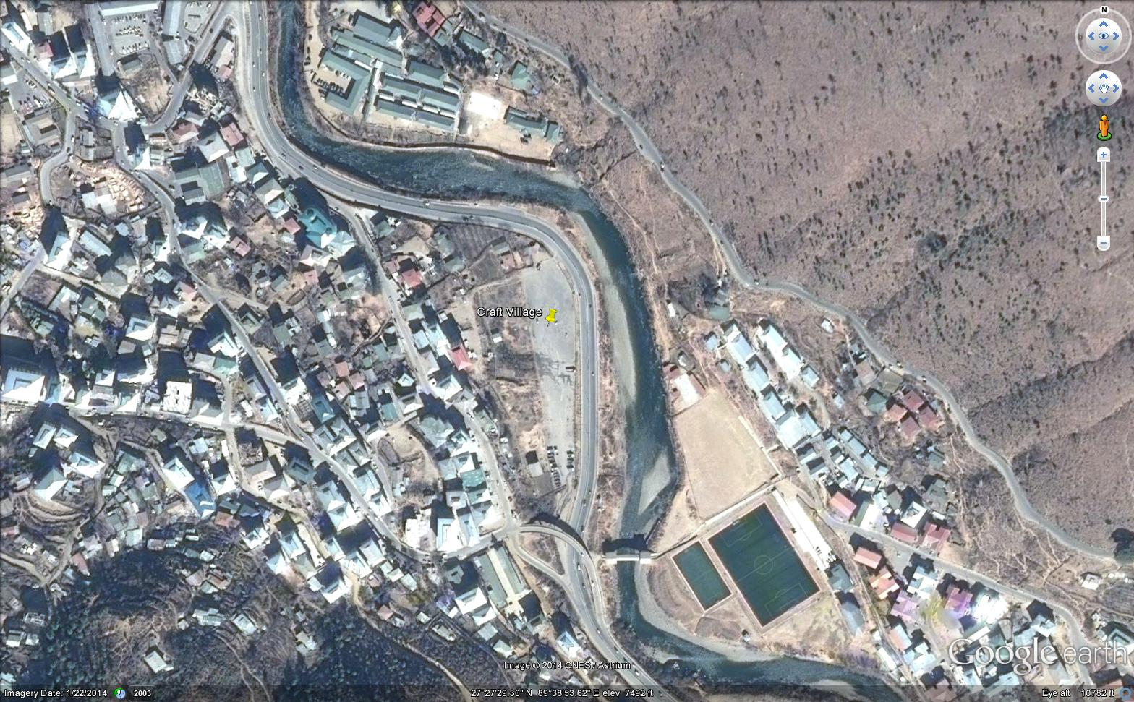
Design boundary adjustment proposal
Include this parcel of land
Samarzingkha
Include River
Expressway
Design boundary
Site
Include the traditional house
Include Bazam

Slide 30
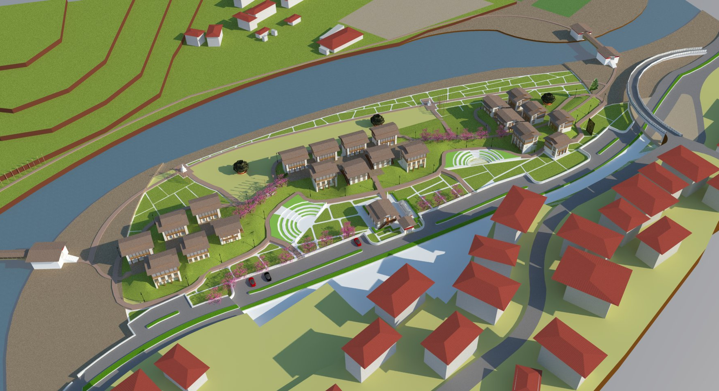
Conceptual View from West

Slide 31
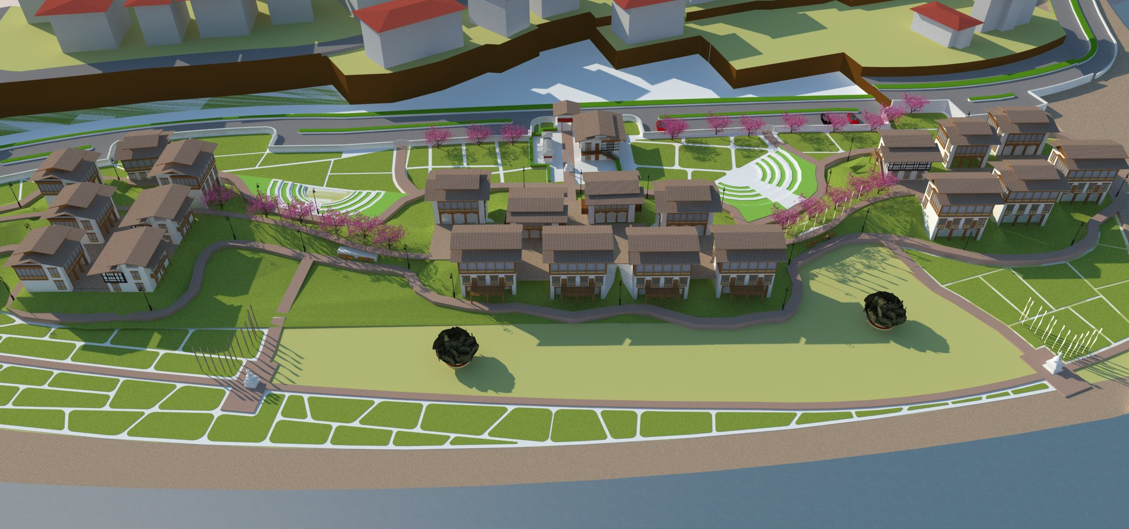
Conceptual close up view from the East

Slide 32
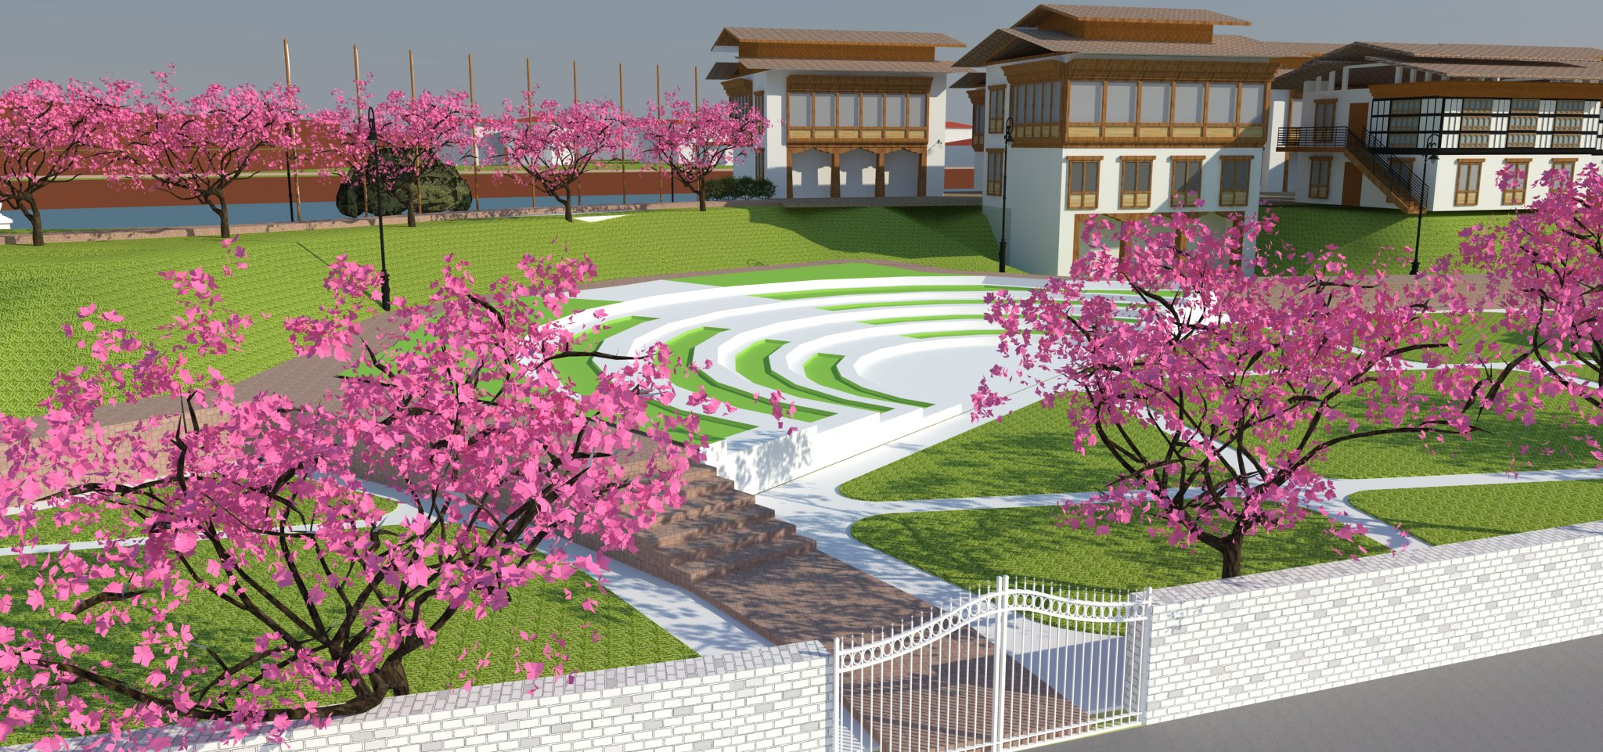
Conceptual view of the OAT, Walkway & Side Entrance

Slide 33
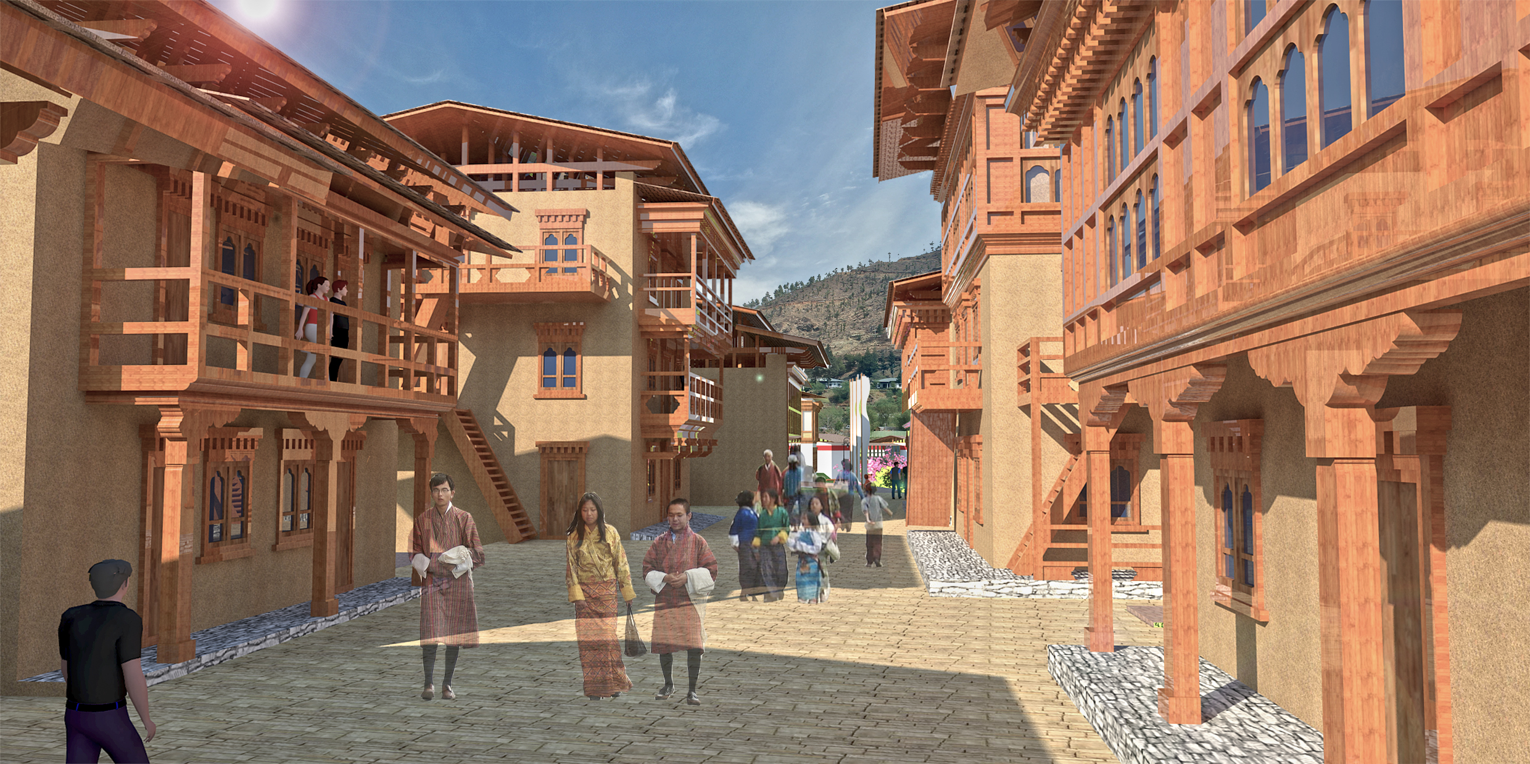

Slide 34
THANK YOU
HOPE OUR DREAMS COME TRUE
SOONER

